Slide 1
Kentucky Department of Agriculture Ryan Quarles, Commissioner
Office of the State
Veterinarian
Robert C. Stout, State Veterinarian
Notes:
Introduction:
Purpose
Overview of NAIS
Mission of KDA/State Veterinarian
Relationship to Animal ID - NAIS

Slide 2
Equine Herpesvirus Myeloencephalopathy:
“Emerging Disease
Challenge of EHM”
Credits
Dr. George Allen*
Dr. Peter Timoney*
Dr. Udeni Balasuriya*
* Gluck Equine Research Center/University of Kentucky

Slide 3
“Characteristics of EHV-1”
Clinical Expression
Endemic & Ubiquitous
Respiratory
Reproductive
Neurologic
Typically 2 – 8 Day incubation
Subclinical infection is common
Currently two strains recognized
Wild
Mutant or Neuropathogenic
Similar range of expression
Different virulence
Both cause latent infection

Slide 4
Characteristics (Cont.)
Latency & Recrudescence
40-60 % Latency in population; life long carrier
Virus not shed during latency
Recrudescence is commonly the initiating source of virus in an outbreak
Stress may activate recrudescence
“Shingles” analogy – valid ??
EHV- 1 Latency Respiratory, Abortion, Neuro Communicable
Chicken Pox Latency Shingles Chicken Pox

Slide 5
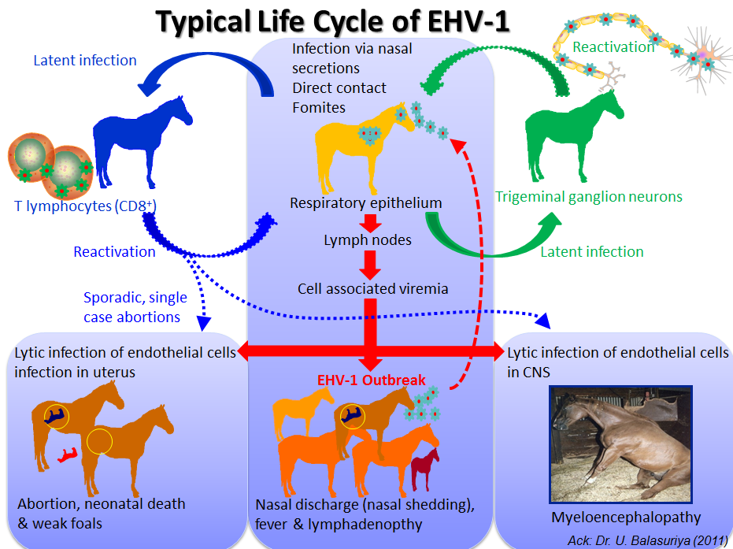

Slide 7
Threshold of Infectivity
Presence of virus does not necessarily equate to disease
Volume of virus shed varies with stage of
infection
Stabling Environment: Open vs. Enclosed
Stress Level
Population Susceptibility
Age
Vaccination Status

Slide 8
Immunity
Previous Exposure – short lived
Passive Antibody
Role of Vaccination:
Prevention of disease
Mitigation of severity
Efficacy is variable
Vaccines – many available
MLV
Killed
None labeled for EHV-1 mutant strain
None labeled for neurologic disease
Schedule varies

Slide 9
II. Diagnosis
Clinical Impression – Differentials
Laboratory Testing
Tests available / where
Sample required
Turn around time
Cost
Interpretation
Confirmation Criteria
“case definition”

Slide 12
PCR - Interpretation Nasal Swab / Whole Blood Buffy Coat
Swab +
Blood +
B +
S +
Blood –
B –
S +
Individual Status
Population Status
Baseline for outbreak
Guides response & exit
strategy
Swab –
B +
S –
B –
S –

Slide 13
IV. Response to Outbreak
Early Detection
Isolation / Segregation / Quarantine
1. ISOLATION: Removal of infected animal(s) to a separate, bio-secure
environment .
2. SEGREGATION: Compartmentalization of animals with like status
using risk based analysis into defined groups.
3. QUARANTINE: Placement of specific restrictions on a premises or
group of animals by the officially authorized agency.
Biosecurity: Routine; Everybody all the time
Vaccination: Controversial
Movement Restriction
Traceability: Forward & Backward
Agent / Vector elimination
Therapy

Slide 14
VI. Communication – Key to Success
Begins with Awareness
Animal Health Officials
Stakeholders
Veterinarians
Hospital / Clinic
Facility Management
Information Clearinghouse
Equine Disease Communication Center (EDCC)
Regulatory Authority
Media: Public & Social
Message Maps (eg. AAEP)

